Slide 1
Putting it all Together: Technical Debt
Damian A. Tamburri, Ph.D.

Slide 2
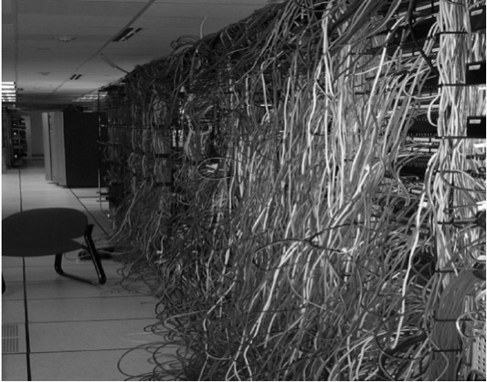
What is technical debt?
Notes:
What is technical debt
Work you put off
Initial compromises that come home to roast
That missing documentation
Tools we used
Static Analysis
Issue is that we don’t see over time

Slide 3
Technical Debt
Whenever code meets functional requirements but is suboptimal or “quick and dirty.” E.g.:
“smelly” code
inefficient algorithms
sloppy design
Might be fixed at code-review, might generate TODOs or new issues in the issue tracker
Understanding and communicating about technical debt is critical in industry

Slide 4
Technical Debt means you get less done as a code base ages
Sprint 1 – new work
Sprint 2 – new work
Debt
Sprint 3 – new work
Debt
Sprint 4 – new work
Debt
Sprint 5 – new work
Debt
Notes:
It builds up over time
It is not as if we don’t have tools to measure it
However, unless we enforce a zero level in the Microsoft space it has been hard to manage

Slide 5
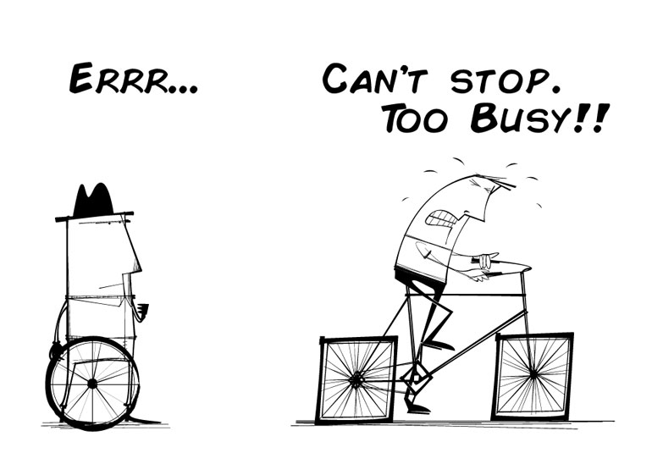
Technical Debt

Slide 6
What is debt (in a financial sense)?
Do you have any financial debts?
Is “debt” (always? ever?) a bad thing?
Is “debt” (always? ever?) a good thing?

Slide 7
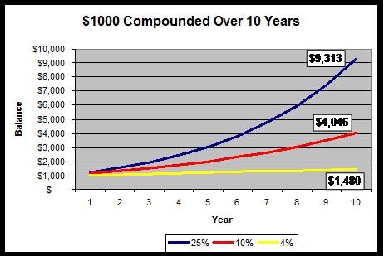
Compounding

Slide 8

What is the idea of “technical debt”?
Sources/Kinds of Technical Debt
Unfit (bad) design
Defects
Insufficient test coverage
Excessive manual testing
Poor integration and release management
Lack of platform experience
Briefly, define each kind

Slide 9
Reasons/Causes of Technical Debt
How do the following types differ?
Naive technical debt
Unavoidable technical debt
Strategic/Deliberate technical debt
Give an example of each type

Slide 10
Debt Analogy
Is debt always bad?
Real life is about shipping code that works
“Shipping first time code is like going into debt. A little debt speeds development so long as it is paid back promptly with a rewrite – the danger occurs when the debt is not repaid. Every minute spent on not-quite-right code counts as interest on that debt.” – Ward Cunningham
Can you afford to do it without debt?
Can you afford the interest?
Can you keep the debt and interest manageable?

Slide 11
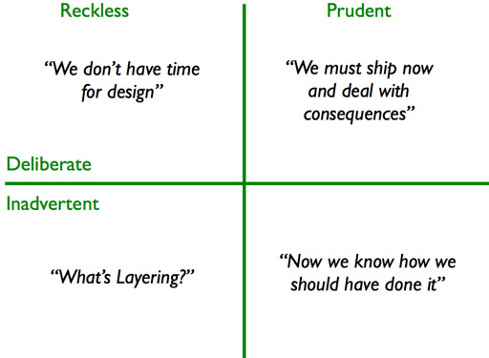
Classes of debt

Slide 12
Strategic, Intentional Debt
Cunningham’s original definition only considered intentional debt - debt can be “planned debt” or it can be “happened-upon” debt, both can be strategic
“Ship now and deal with the consequences later”
Examples of intentional or strategic debt:
Non-modular design
Purposefully too-simple/too-complex implementation
Performance indifference
Lack of generality or extensibility
Lack of scalability

Slide 13
Non-Strategic, Unintentional Debt
Debt also accumulates unintentionally, no development process is perfect
Examples of unintentional or non-strategic debt:
Memory leaks
Insufficient test coverage
Unintentionally complex implementation
Rigid/brittle architecture
Performance or scalability bottlenecks
Sloppy or difficult to maintain code

Slide 14
Consequences of Debt
Too much debt => too much time paying interest
Unpredictability in software planning stage, increased risk of investment
Slows down future work
More bugs, more expensive to fix them
Frustrated, unhappy developers

Slide 15
Debt Tradeoff
Zero-Debt Product
Technical Debt
Working Features
Indebted Product
Rapid Progress
Debt Value Inflection - Too much time is spent paying interest and development slows to a crawl
Over-Engineered
Time, Size, Lines-of-Code, etc.

Slide 16
Communicating Debt
Writing good code isn’t just a matter of professionalism or craftsmanship:
There is no moral or intellectual imperative to produce good code
Every bit of debt incurred today reduces your future ability to produce working features
Technical debt has a real cost- not “interest” as we have described- your future productivity… your manager will literally pay for it later
Likewise, writing good code or refactoring costs more now, but results in savings later

Slide 17
Debt Avoidance
Non-strategic debt is not helpful by definition
Avoid non-strategic debt:
Use good engineering practices – test-driven development, good architectural patterns, etc.
If you’re not actively working to make your system simpler and with less cruft, it’s getting worse
Strong “definition of done”- user requirements are the baseline, how much debt are you willing to accept each sprint or for each feature?
Refactoring- reducing debt without changing behavior

Slide 18
Debt Management
Known debt is everything recorded in an issue tracker or product backlog
Devoting effort to get rid of that debt is a quantifiable business decision
Doesn’t always make sense to work on debt: e.g. prototypes, end-of-life software, small projects
Good practice to pay down debt a little at a time versus ignoring it and making a “balloon payment”
When you find debt- use the “boy scout principle”: clean up what you can, log the rest as known debt, leave the camp cleaner than you found it

Slide 19
Accumulation of Technical Debt
False “acceleration”
Deadline pressure
Decreased verification
Cumulative debt effects (decreasing velocity)

Slide 20
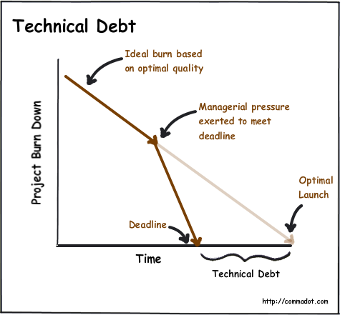
Accumulation of Technical Debt due to deadline pressure
Debt
time saved to product release

Slide 21
Consequences of Technical Debt
Rising development & support costs
Increased delivery time
Significant # of defects
Decreased customer satisfaction
Unpredictable tipping point
Universal frustration (morale)
Product atrophy (Defect Sprints)
Under-performance
Decreased predictability

Slide 22
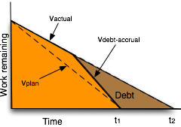
Paying debt from “false acceleration”
Additional time needed to service previous debt

Slide 23
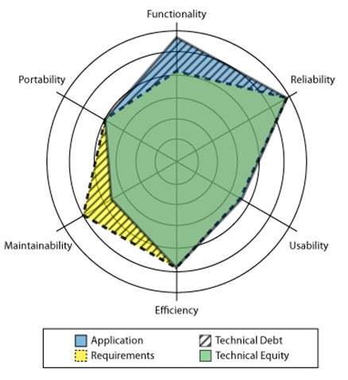
Technical debt is a gap

Slide 24
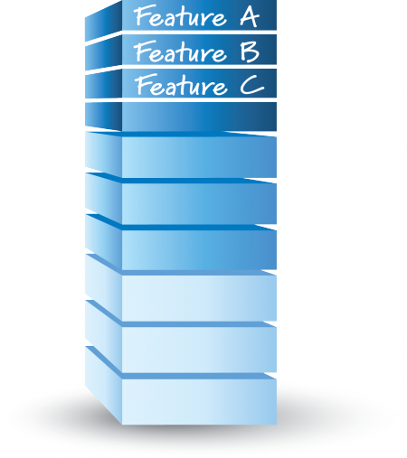

Making Technical Debt Visible
Technical Debt Backlog (Defect PBIs, Internal Improvement PBIs)
Feature Backlog

Slide 25
Managing Technical Debt
Managing debt accrual | Making debt visible | Servicing the debt
Good technical practices | Visibility at the business level (balance sheet) | Deciding whether to repay
Strong “done” definition | Visibility at the technical level (defects, PBIs, cards) | Repay when found, incrementally, high-interest first
Understanding of debt economics (delay vs repayment costs) | Technical Debt Items in Product Backlog | Repay while producing value (avoid balloon payments)

Slide 26
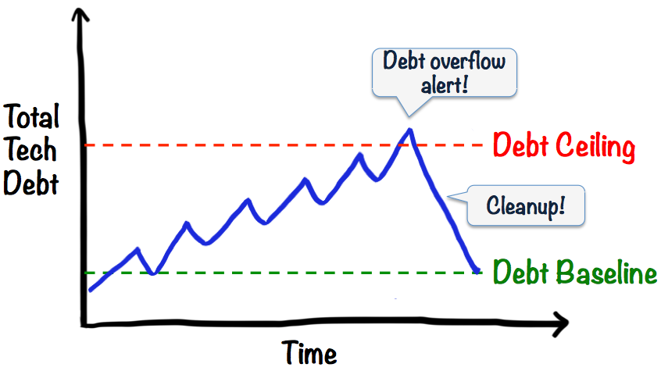
Servicing Technical Debt

Slide 27
Properties of debt
Visibility. Significant problems arise when debt is not visible. In many cases, it is (or was) known to some people but it is not visible enough to others who eventually have to pay for it.
Value. In its financial use, debt when managed correctly is a device to create value
Present value. In addition to the overall potential system value enabled by technical debt, the present value of the costs incurred as a result of the debt, including the time-to impact and uncertainty of impact, must be mapped to the overall cost-benefit analysis.

Slide 28
Properties of debt - 2
Debt accretion. Debt does not necessarily combine additively, but super-additively in the sense that taking on too much debt leads a system into a bad, perhaps irreparable state
Environment. In software engineering projects, debt is relative to a given or assumed environment.
Origin of debt. It is important to distinguish sharply between strategic debt, taken on for some advantage, and unintentional debt, that is taken on either through poor practices or simply because the environment changed in a way that created a mismatch that reduces system value.

Slide 29
Properties of debt - 3
Impact of debt. The locality (or lack thereof) of debt is important: are the elements that need to be changed to repay a debt localized or widely scattered?

Slide 30
Assessing Technical Debt
Complexity
Code Duplication
Documentation Debt
Testing Debt
Architectural Debt

Slide 31
Research issues
Refactoring
Architectural issues
Identifying dominant sources of debt
Measurement issues
Non-functional artifacts
Monitoring
Process issues

Slide 32
Architecture technical debt
Dependencies that exist in the current architecture but that should not exist are technical debt.
reference architecture
meta-architecture
enterprise architecture

Slide 33
Entropy reduction
Use code tags.
Establish a rhythm.
Time-box the ER activity
Don’t ship the result
Choose your language carefully
Use ER to reinforce other values you deem important
Don’t commit unless you can deliver.

Slide 34
Why no-one repays technical debt
Business people don’t see technical debt.
Perceived low ROI.
Developers don’t like repaying technical debts.
Development processes don’t focus on it.

Slide 35
Managing Technical Debt…Where are we?
Tools & automations
Org. Culture
Social Debt?

Slide 36
What tools do we have in Sw.eng. land?
Compiler Errors/Warnings
FXCop/Code Analysis
StyleCop
Unit Test Coverage
Numerous other tools….
But they are snapshots in time, we need a better dashboard

Slide 37
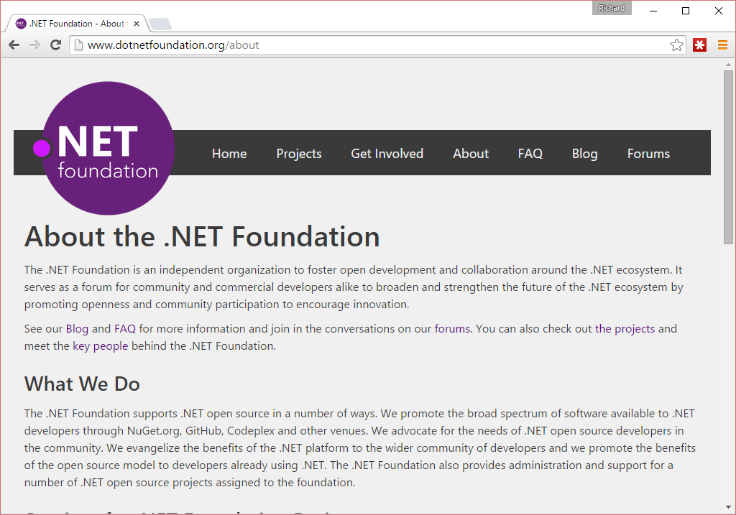
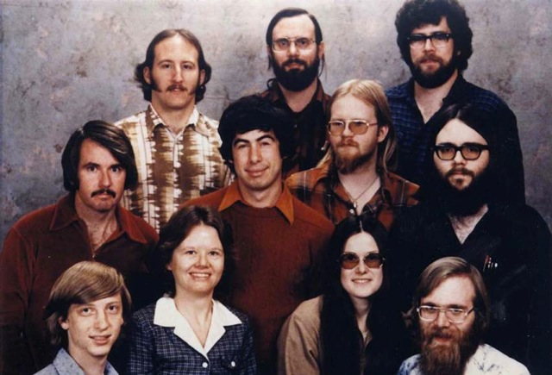
This is not your grandfather’s Microsoft
Microsoft staff in 1978
Notes:
Not your old Microsoft
Pick a market leader
Work with the team
Leverage what Roslyn can do
Provide a viable alternative to StyleCop/FxCop and more

Slide 38

Introducting SonarQube
To quote the product homepage…
“The SonarQube® platform is an open source quality management platform, dedicated to continuously analyzing and measuring the technical quality of source code, from project portfolio down to the method level. To understand what the platform tracks and why it's important, take a look at the Developers' Seven Deadly Sins.”
Notes:
Popular in the Open Source space, used to be called Sonar

Slide 39
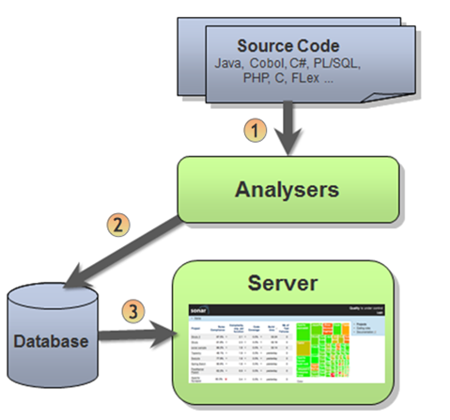
SonarQube Architecture
SonarQube Scanner Command-line Tool to analyze source code
SonarQube Scanner for Maven Integrate source code analysis to Apache Maven builds
SonarQube Scanner for MSBuild Integrate source code analysis to any .Net projects
SonarQube Scanner for Ant Integrate source code analysis to Apache Ant builds
Notes:
Currently the runner needs access to DB

Slide 40
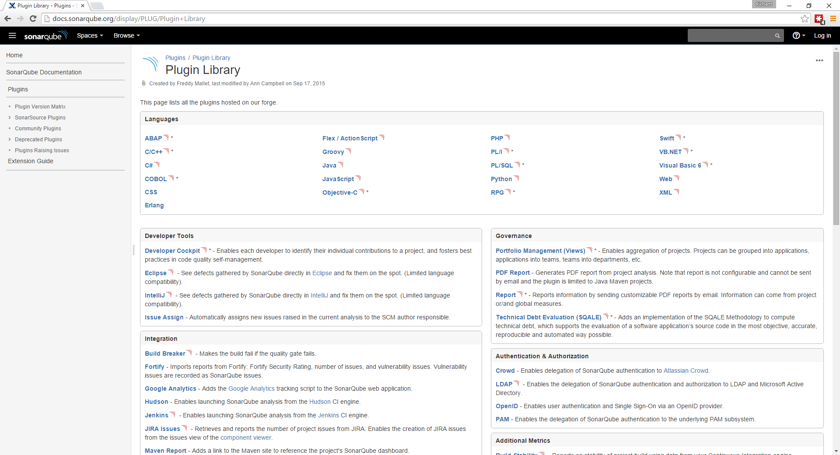

Slide 41
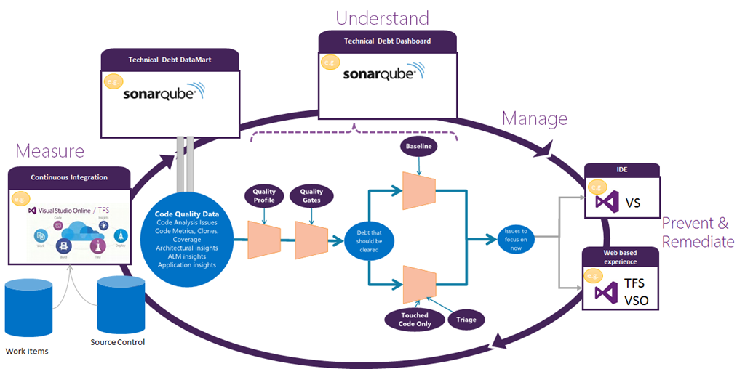
Notes:
How Microsoft see it fitting in

Slide 42
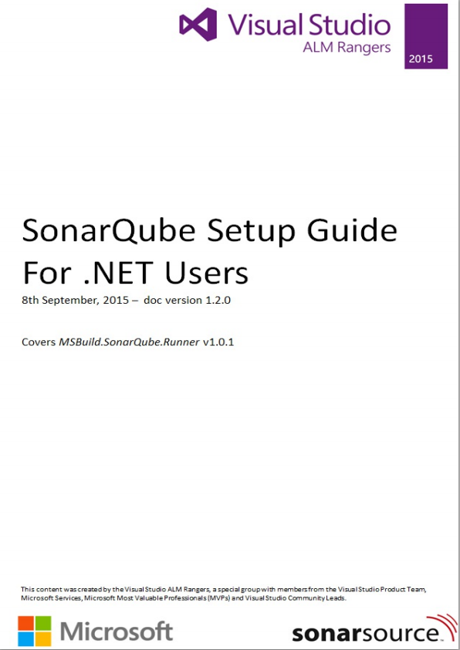
Setup of SonarQube
Has a few gotcha’s so
See the ALM Rangers Guide
https://github.com/SonarSource/sonar-.net-documentation
Also see SonarQube site
http://docs.sonarqube.org/display/SONAR/ Setup+and+Upgrade

Slide 43
Installation – Server Requirements
A VM
1 Gb of memory
Can be Windows or Linux
.NET 4.5.2 (for the MSBuild Runner)
Java
Oracle JRE 7 (or greater)
OpenJDK 7 (or greater)
Database
H2 (for demo only)
Microsoft SQL Server 2008 or later
Oracle 10G/11G with Oracle 11.2x drivers
MySQL 5.1 (or greater)
Web Browser
IE 9+
And all other current browsers
Notes:
Remember you need a Java patching plan
The easiest is to use the H2 document DB, but only works if everything on done box

Slide 44
Installation – Setup Microsoft SQL
You need a real DB – but SQL Express is enough
Beware the JDBC drivers, from my experience
They are not fond of clustering
Or of integrated Windows security
DB names are case sensitive
Collation must be set to case-sensitive (CS) and accent-sensitive (AS) e.g. SQL_Latin1_General_CP1_CI_AS
Process
Create and empty DB
Create a user and grant rights as owner of the empty DB
Remember the values as they need to go in a various config files
Open port 1433 in the SQL server firewall

Slide 45
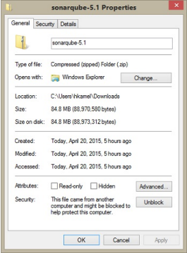
Installation – SonarQube Server
Install the JRE
Download sonarqube-5.x.zip
Make sure the ZIP is unblocked
Unzip it to a folder e.g: C:\sonarqube
Edit C:\sonarqube\conf\sonar.properties to set the connection string and authentication sonar.jdbc.username=sonaruser sonar.jdbc.password=Pass@w0rd1 sonar.jdbc.url=jdbc:jtds:sqlserver://localhost/Sonar;SelectMethod=Cursor
(There is more settings you can edit, but these should be enough)
Open port 9000 in the server firewall

Slide 46
Installation – Plug-Ins
Can be installed manual
Download the C# Plug-in from SonarQube
Make sure the ZIP is unblocked
Unzip it
Drop the JAR file in C:\sonarqube\extensions\plugins
Or via the SonarQube management UI

Slide 47
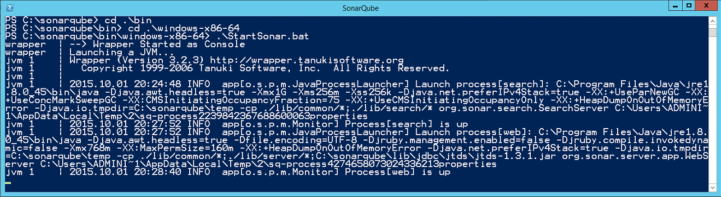
Installation – Start the Server
Use a script from C:\sonarqube\bin
Probably best to start using .\windows-x86-64\StartSonar.bat
Look in C:\sonarqube\logs if you have problems

Slide 48
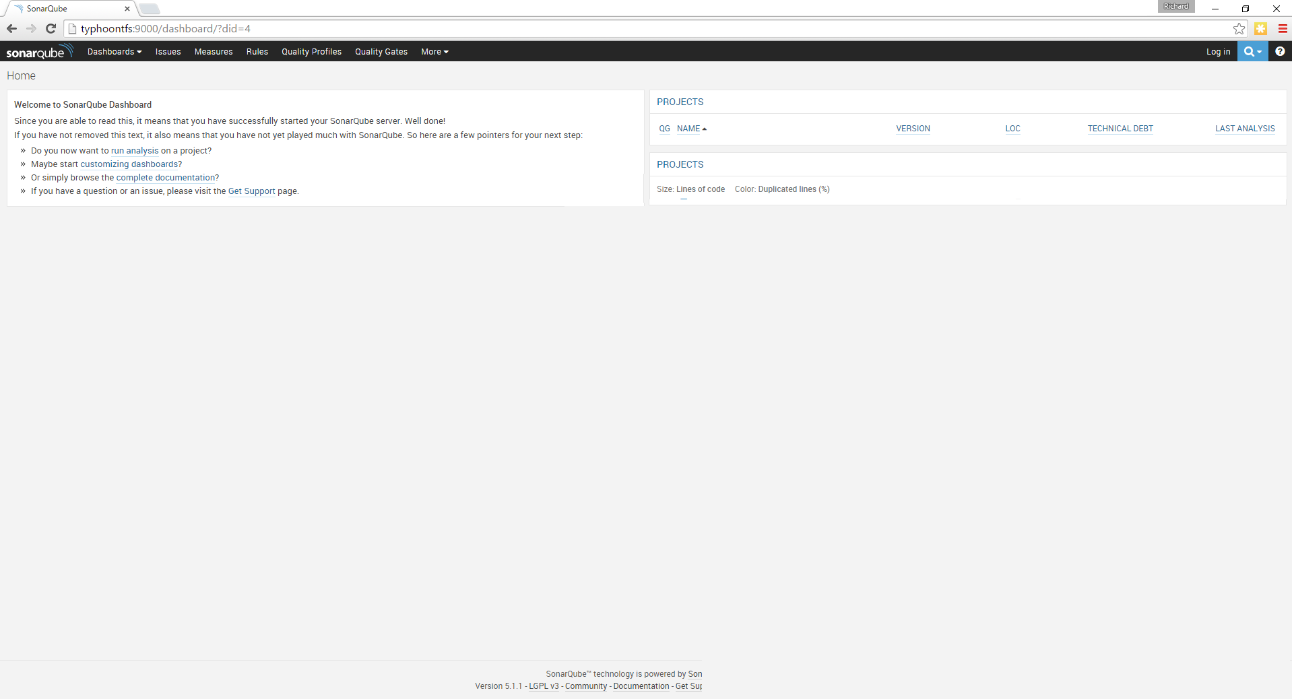
Notes:
Should see something like this

Slide 49
Install – The Sonar Runner
On a PC with the code to analyse
Download from SonarQube
http://www.sonarqube.org/downloads/
Unblock and unzip
Set the DB connection details in the .\Conf\sonar-runner.properties
Consider adding editing the Windows Path

Slide 50
Analysis from the command line
Create a sonar-project.properties in root of your project
Run the batch file sonar-runner
# must be unique in a given SonarQube instance
sonar.projectKey=my:project
# this is the name displayed in the SonarQube UI
sonar.projectName=My project
sonar.projectVersion=1.0
# Path is relative to the sonar-project.properties file. Replace "\" by "/" on Windows.
# Since SonarQube 4.2, this property is optional if sonar.modules is set.
# If not set, SonarQube starts looking for source code from the directory containing
# the sonar-project.properties file.
sonar.sources=.
# Encoding of the source code. Default is default system encoding
#sonar.sourceEncoding=UTF-8
http://docs.sonarqube.org/display/SONAR/Analyzing+with+SonarQube+Runner

Slide 51
Run as part of a Build
Option 1
Just use the same command line script
Option 2
Use task/activity appropriate to your Build system
ANT
Maven
MSBUILD

Slide 52
Install – The MSBuild Runner
This generates the sonar-project.properties automatically
Probably need to install this on a build VM (with a JRE)
Download from SonarQube
http://www.sonarqube.org/downloads/
Unblock and unzip
Set the DB connection details in SonarQube.Analysis.xml

Slide 53
Run from the command line
You can still manually run the processing
C:\myproject>
C:\myproject>MSBuild.SonarQube.Runner.exe begin /key:{SonarQube project key} /name:{SQ project name} /version:{SQ project version}
C:\myproject>Msbuild
C:\myproject>MSBuild.SonarQube.Runner.exe end
Powershell

Slide 54
Integration with TFS Build
Option 1
Call MSBuild.SonarQube.Runner.exe via pre/post scripts
Option 2
Use a TFS build task (that does the same behind the scenes)

Slide 55
Demo
Build Automation
Notes:
Show a build running
Mention uploading a task
See process on http://realalm.com/2015/07/31/uploading-a-custom-build-vnext-task/
Install npm/gulp
Clone the repo https://github.com/Microsoft/vso-agent-tasks
Run gulp
Look in the _build folder
Use https://www.npmjs.com/package/tfx-cli to upload – remember needs basic auth and full TPC name
tfx login --authtype basic
tfx build tasks upload --taskpath .\_build\Tasks\SonarQubePostTest\
tfx build tasks upload --taskpath .\_build\Tasks\SonarQubePreTest\
Add the tasks to the build
Provide the sonarqube server
If < SonarQube 5.2 need to provide the Db connection strings

Slide 56
So what do I see in SonarQube?
Dashboards
Tables and Charts
Trends over time
Base-lines based on version
Technical Debt time estimates
Quality Ratings
Quality Gates

Slide 57
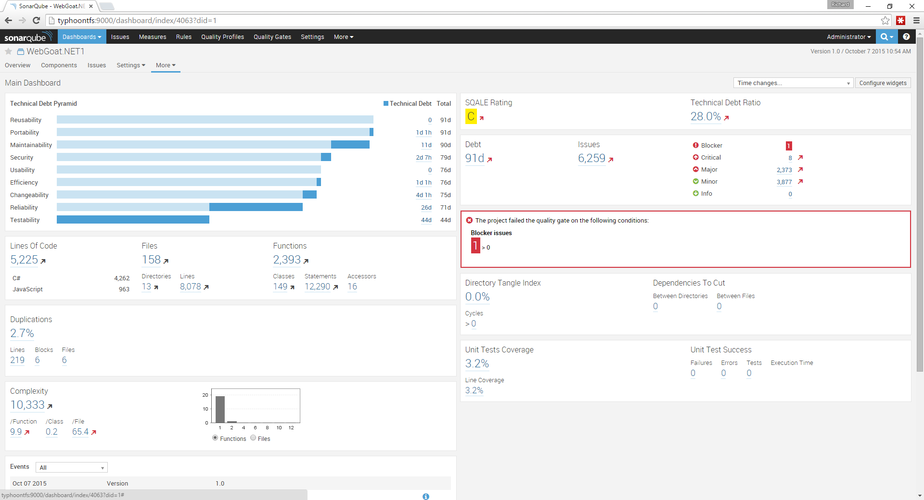

Slide 58
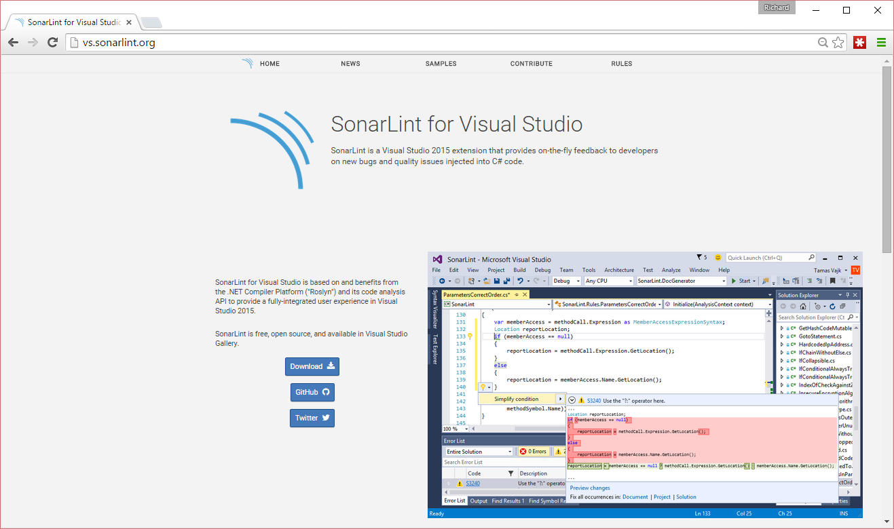

Slide 59
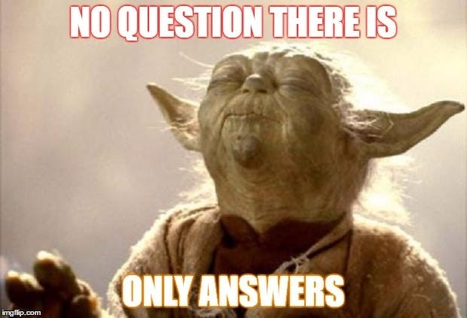
Questions?

Slide 60
Resources
SonarQube
http://www.sonarqube.org/
Microsoft Product Team on Technical Debt
http://blogs.msdn.com/b/visualstudioalm/archive/tags/managing+technical+debt/
ALM Rangers Guide on SonarQube
https://github.com/SonarSource/sonar-.net-documentation http://blogs.msdn.com/b/visualstudioalmrangers/archive/tags/vsartechnicaldebt/
SonarLint
http://vs.sonarlint.org/
Find these slides
https://github.com/rfennell/Presentations

